Slide 1

WELCOME
To
An Online Food Order And Management System

Slide 2
Developed By:
Mohammad Jobair
1703310201526
5th semester
Mohammad Tokir-ul-Hasan
1703310201510
5th semester
Mohammad Abdullah
1703310201523
5th semester

Slide 3
Project Introduction
Our project is about an Online Food Order and Managing System. This web application gives facilities to the user or customer to view food menu, ordering food with online payment and order tracking etc. It also gives the facilities of managing food item, food order, sales and category to an admin.

Slide 4
Motivation
With the improvement of technology, online food ordering systems are becoming a popular topic. That's because they are serving the ever increasing demand for convince. The main purpose of an online ordering system is to provide customers for a way to place an order over the internet. So it benefits both the customer and the business. With a website or mobile app, customers can easily browse all the dishes the restaurant has available, customize dishes to their requirements and place an order. It can also save their favorite orders allowing them to easily re-order that in the future. From the restaurants perspective, they no longer spend time taking the customers order, stop worrying about communication errors and streamline their order management workflow. It also save both time and money. That’s why we choose this project.

Slide 5
Features
Features for User.
Viewing food category-wise and order food.
Payment with card or cash.
Rating Food.
Tracking order etc.
Features for Admin.
Managing food order request by Confirming, Rejecting and Delivery.
Add, Delete and Update food and category.
Adding Sub-admin and delivery Boy.
Managing Payment Status and User etc.

Slide 6
Technologies Used
html, CSS, java script used for UI design.
Mysql used for database.
PHP as server side scripting language.
Framework is designed by Bootstrap.

Slide 7
Methodology
Process Model
There are many process model in software development. Incremental Process Model is one of them. We followed the Incremental Process Model as we knew and clearly understood major requirements of the food order system and our team were not very well skilled or trained. So, we broken down the system development into many mini development and highest priority requirement tackled first. Then marge the partial systems successively to produce the final total system.

Slide 8
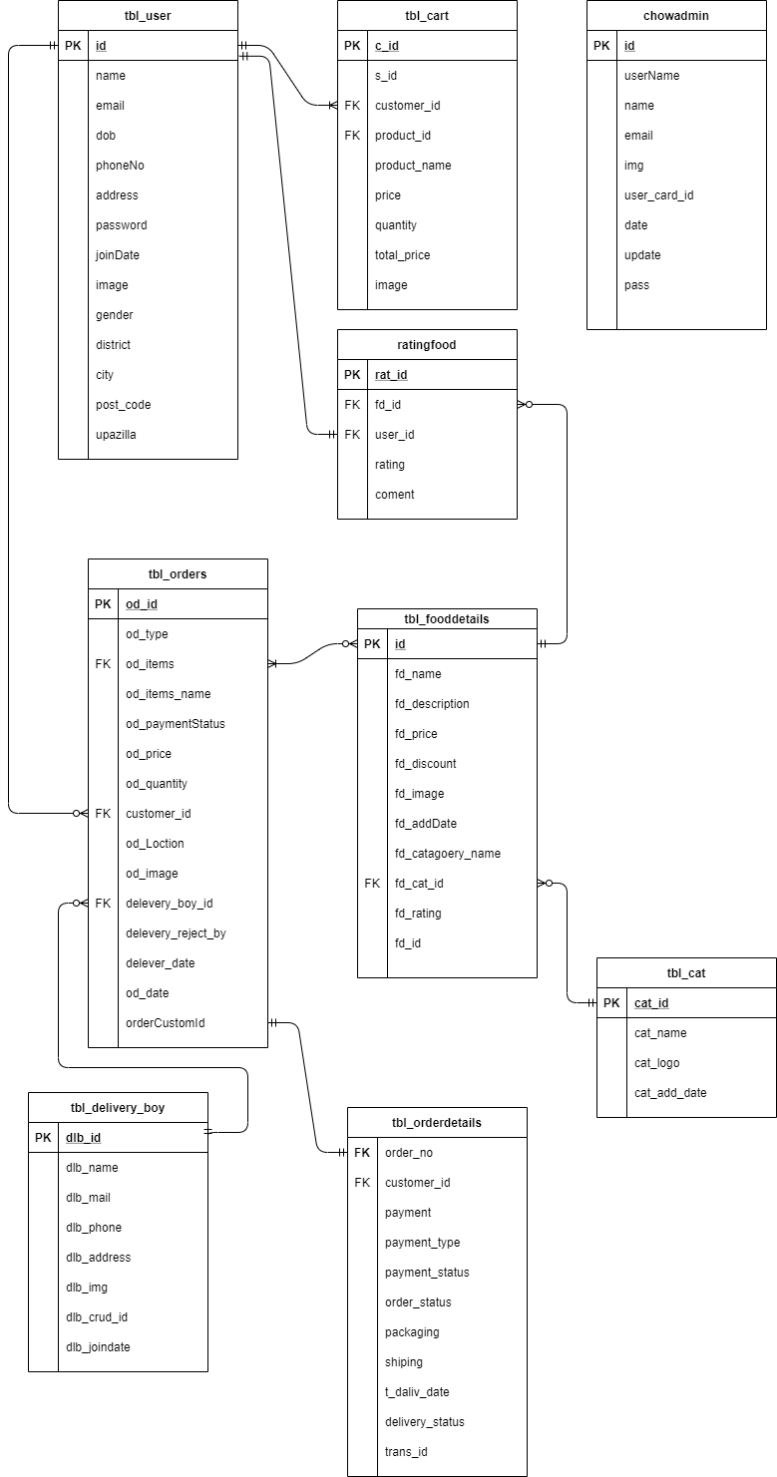
ER Diagram

Slide 9
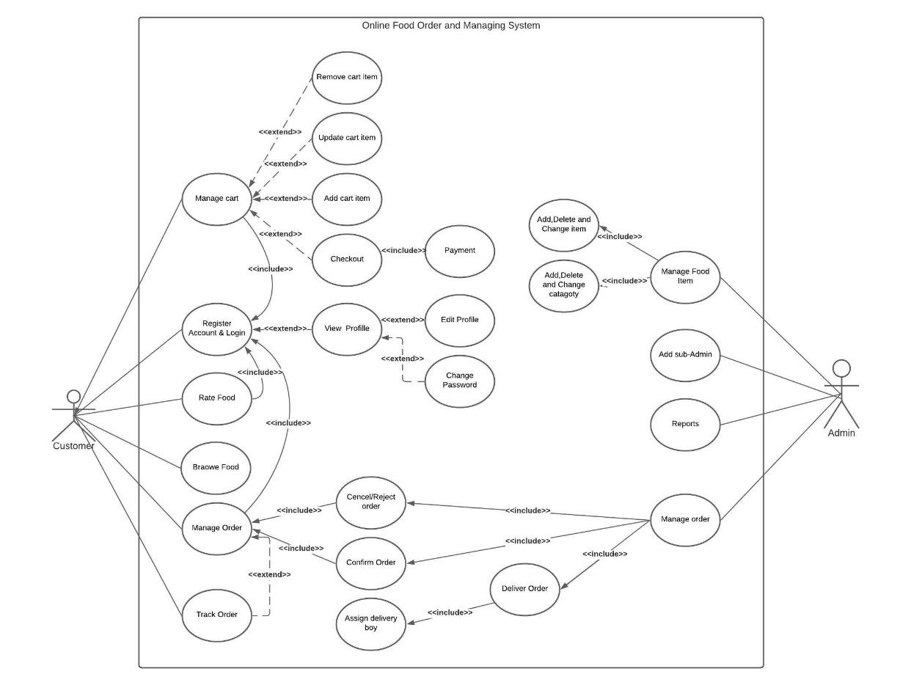
Use Case Diagram

Slide 10
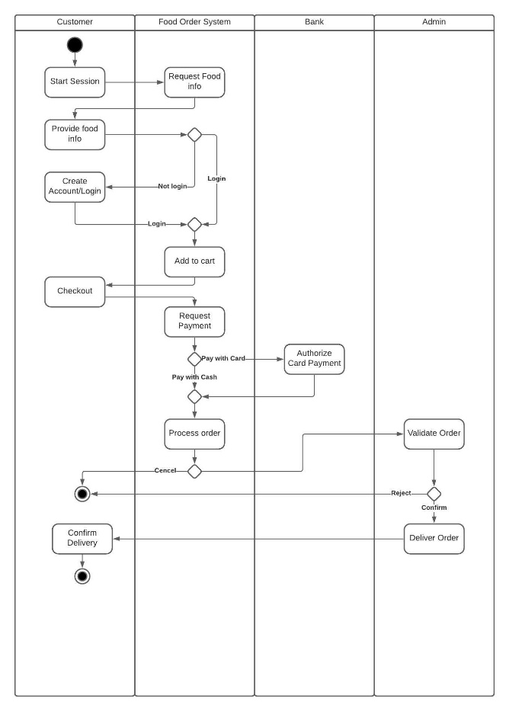
Activity Diagram

Slide 11
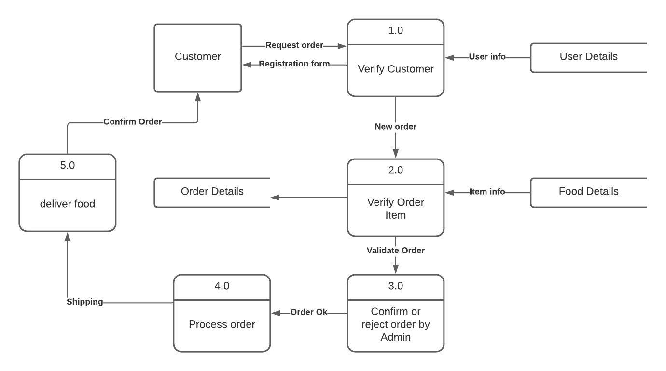
Logical DFD

Slide 12
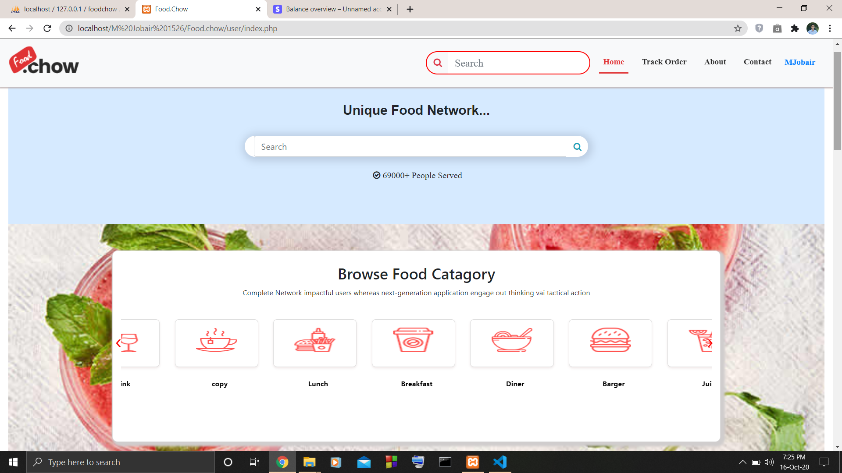
Screenshots of some important features

Slide 13
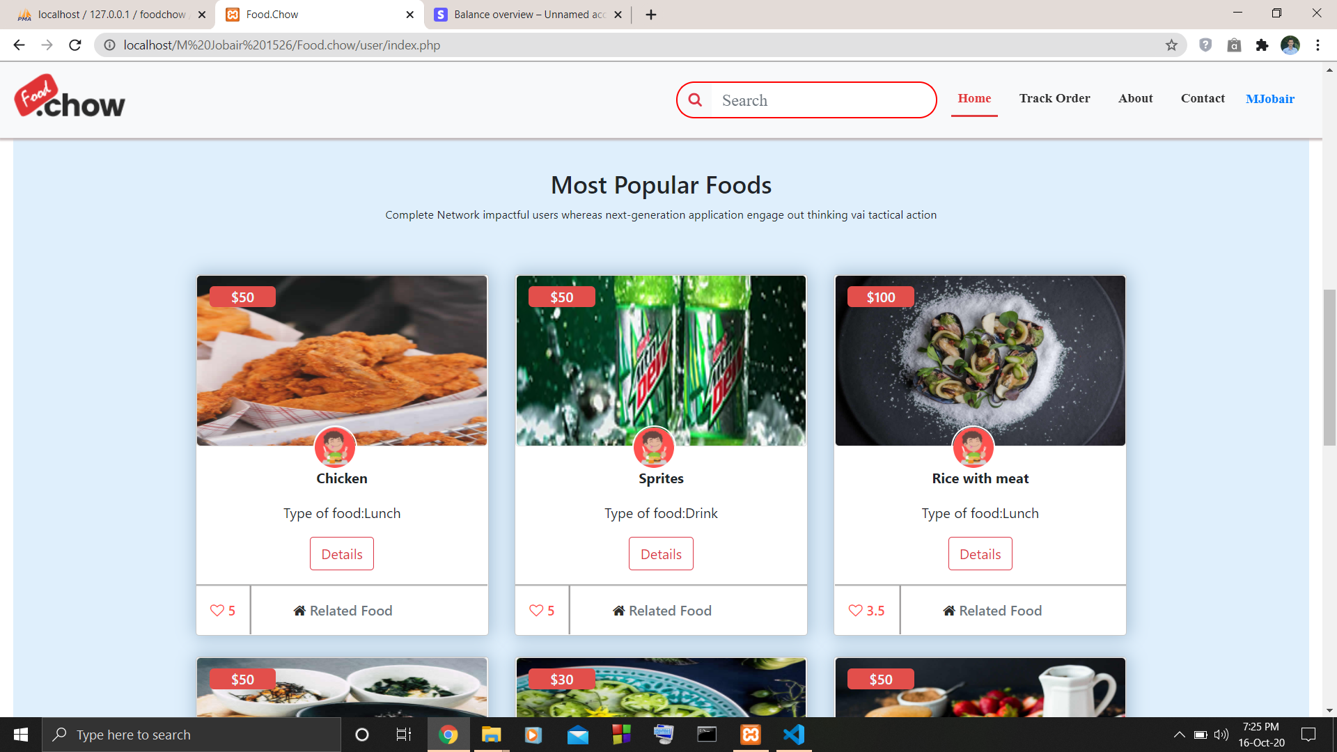
Screenshots of some important features

Slide 14
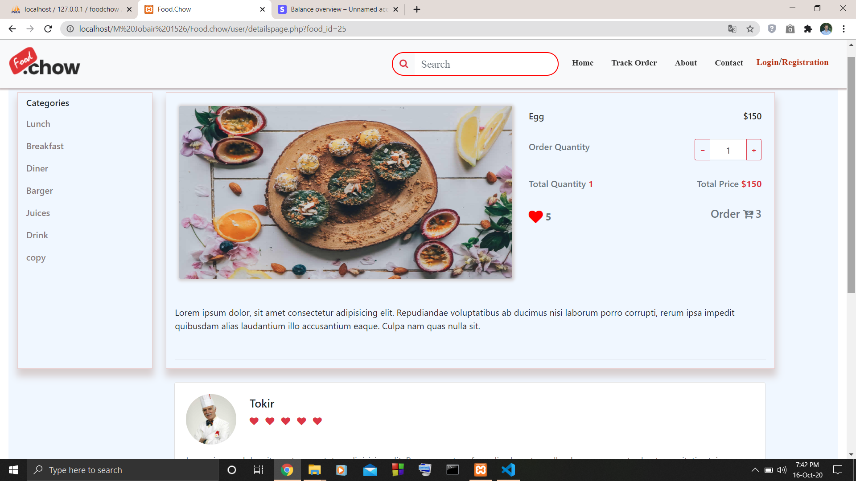
Screenshots of some important features
Food Details without user login

Slide 15
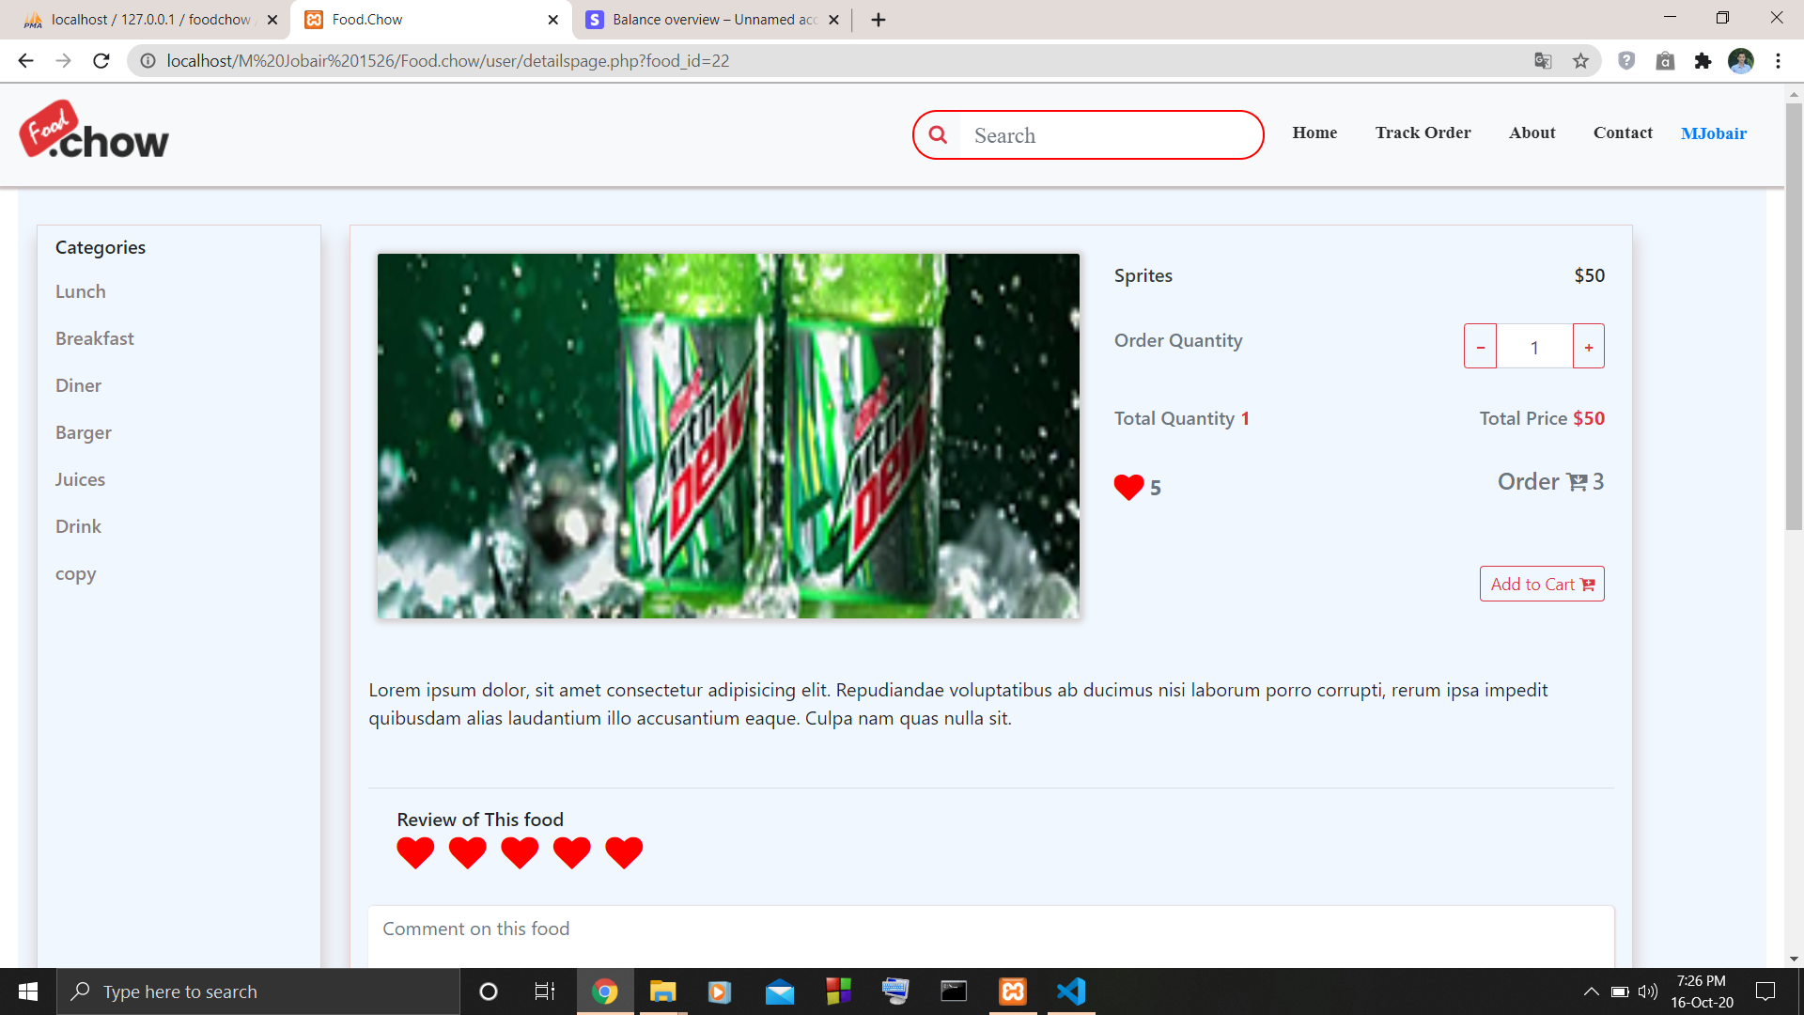
Screenshots of some important features
Food Details user login

Slide 16
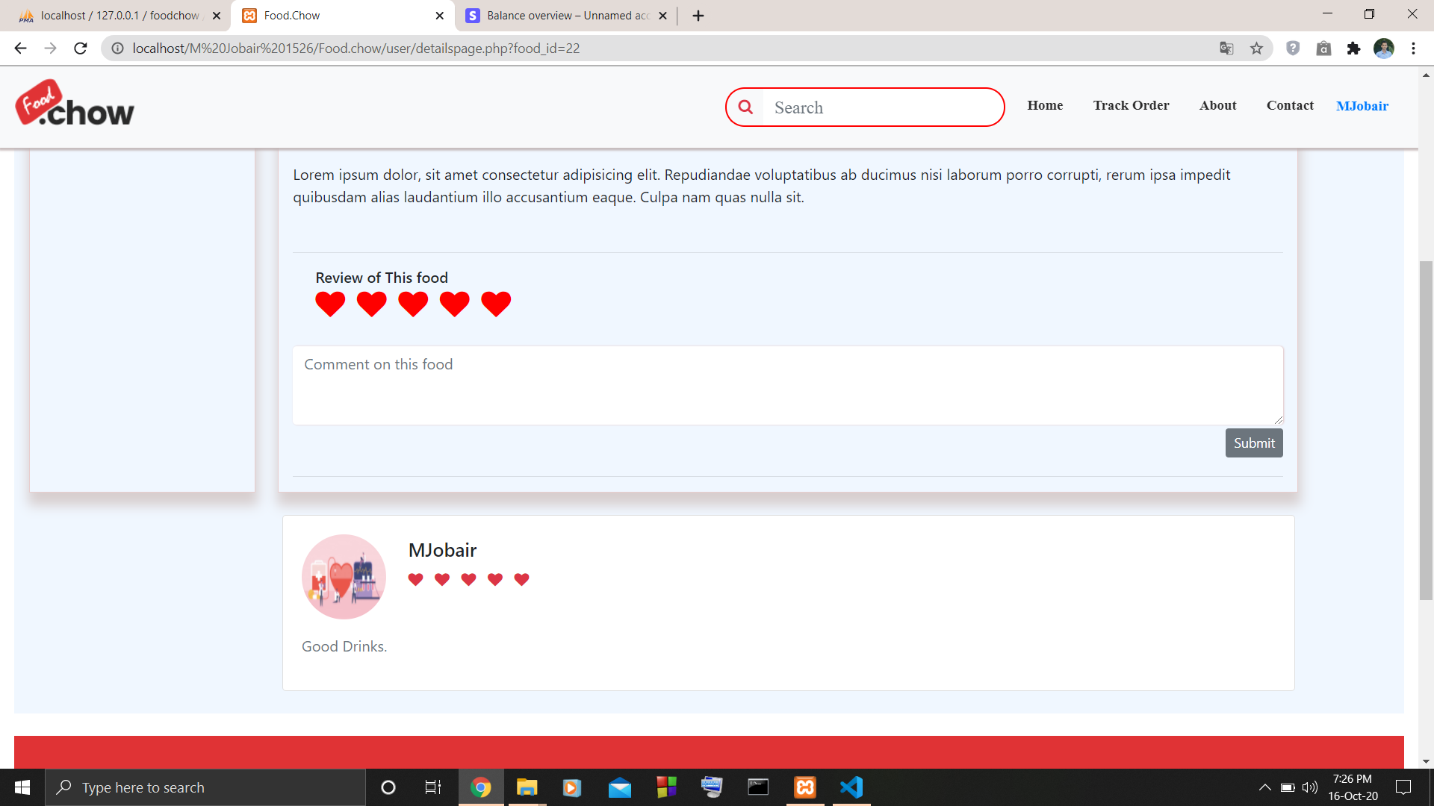
Screenshots of some important features

Slide 17
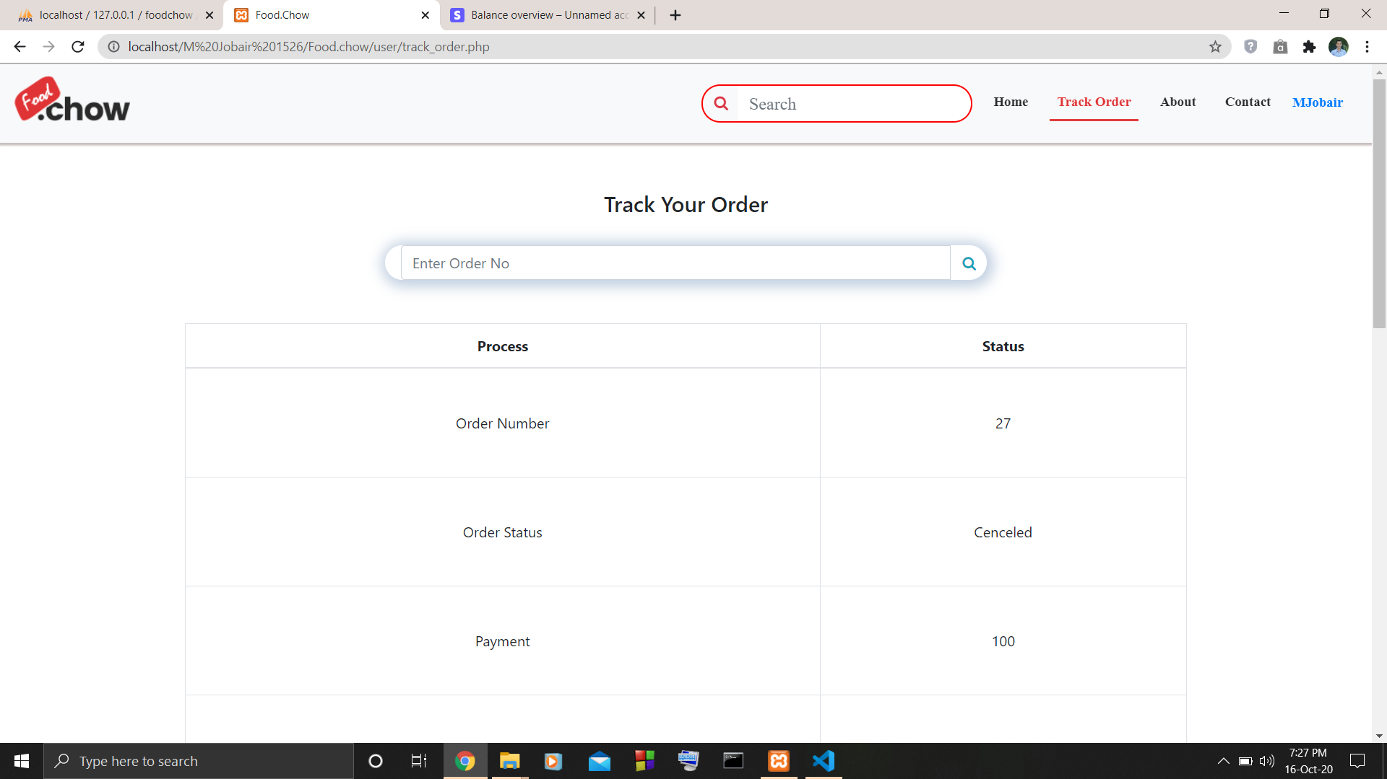
Screenshots of some important features

Slide 18
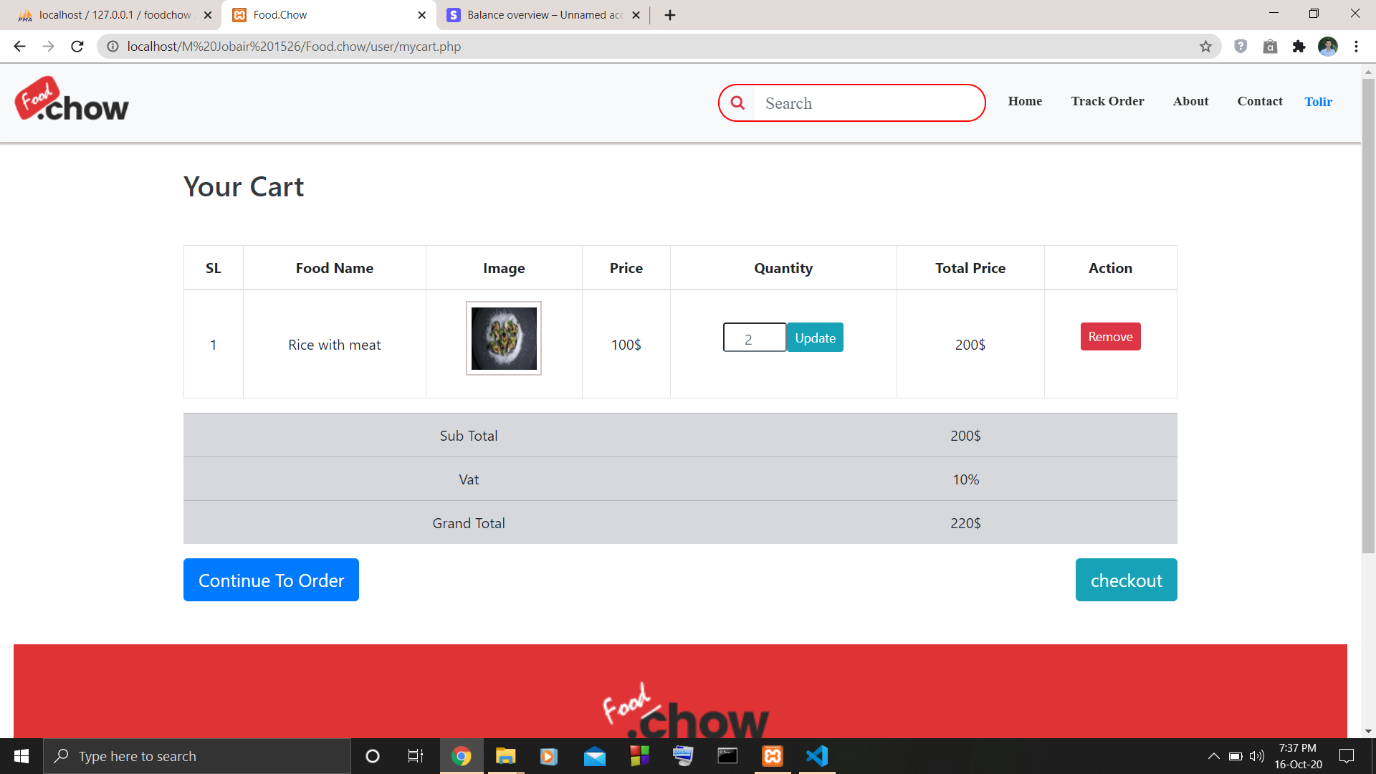
Screenshots of some important features

Slide 19
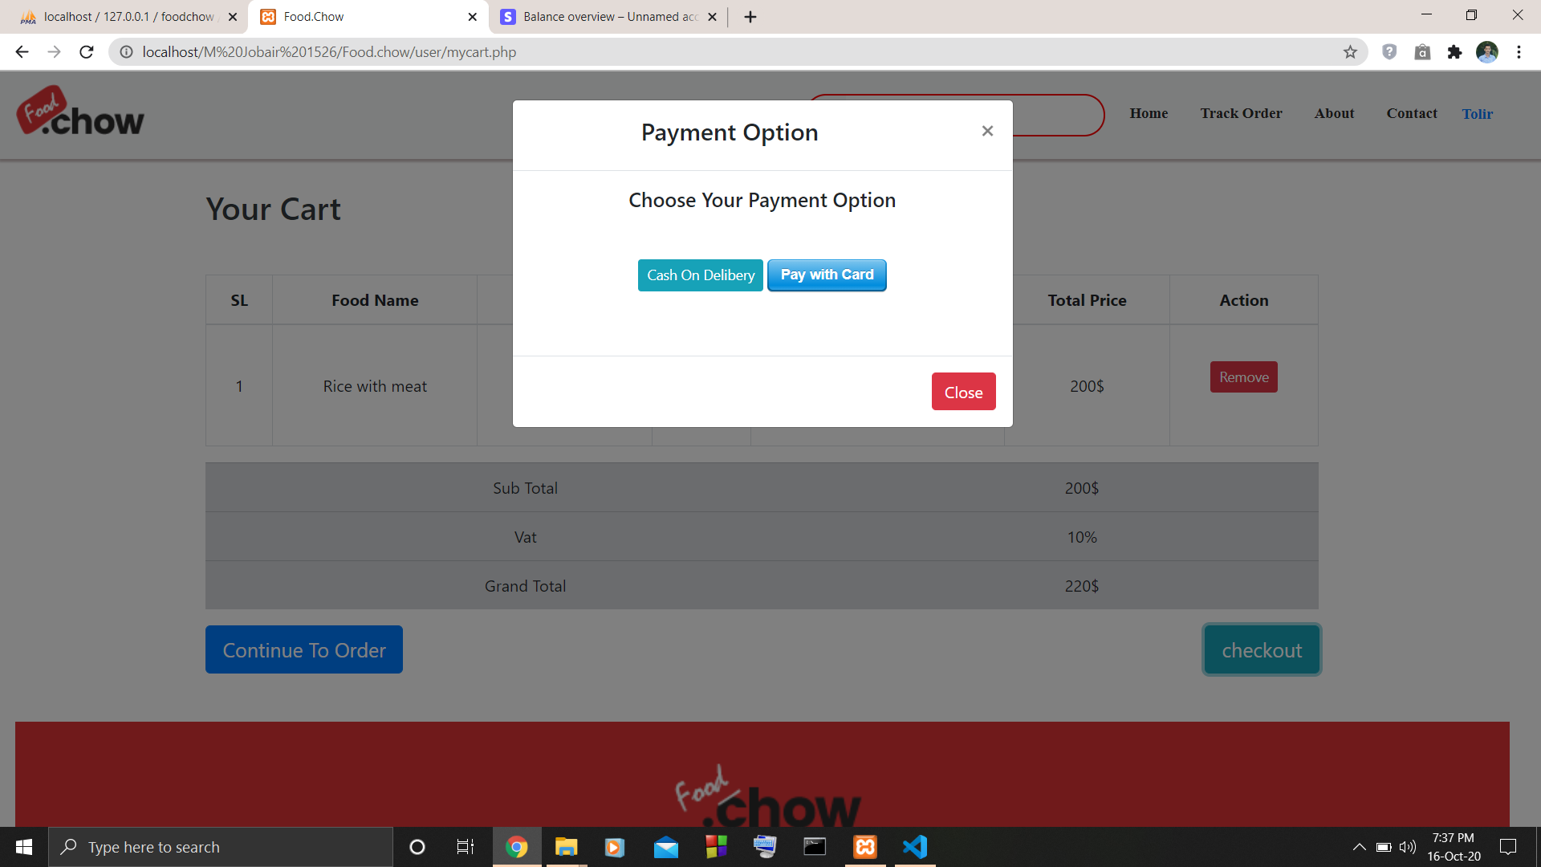
Screenshots of some important features

Slide 20
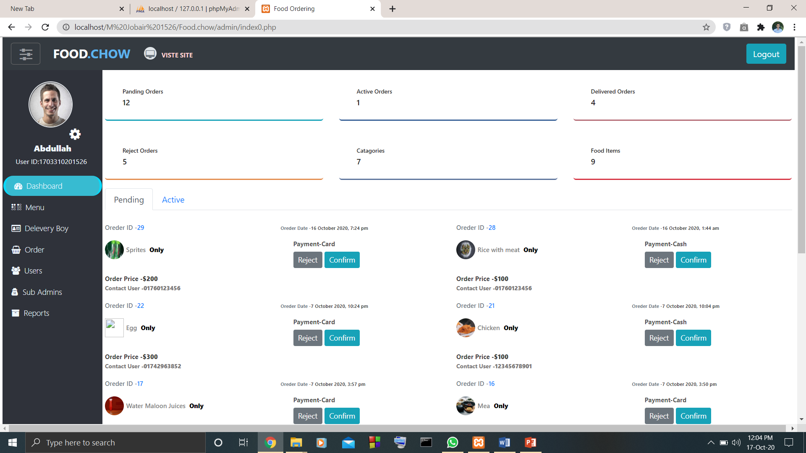
Screenshots of some important features(Admin)

Slide 21
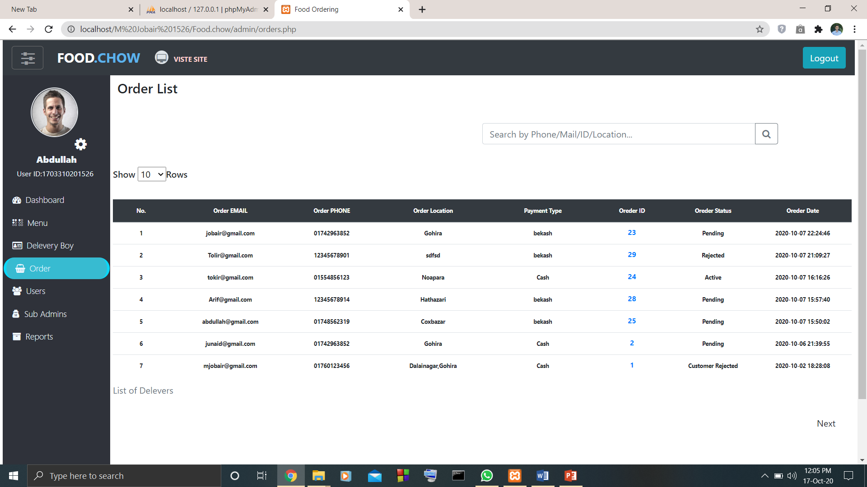
Screenshots of some important features

Slide 22
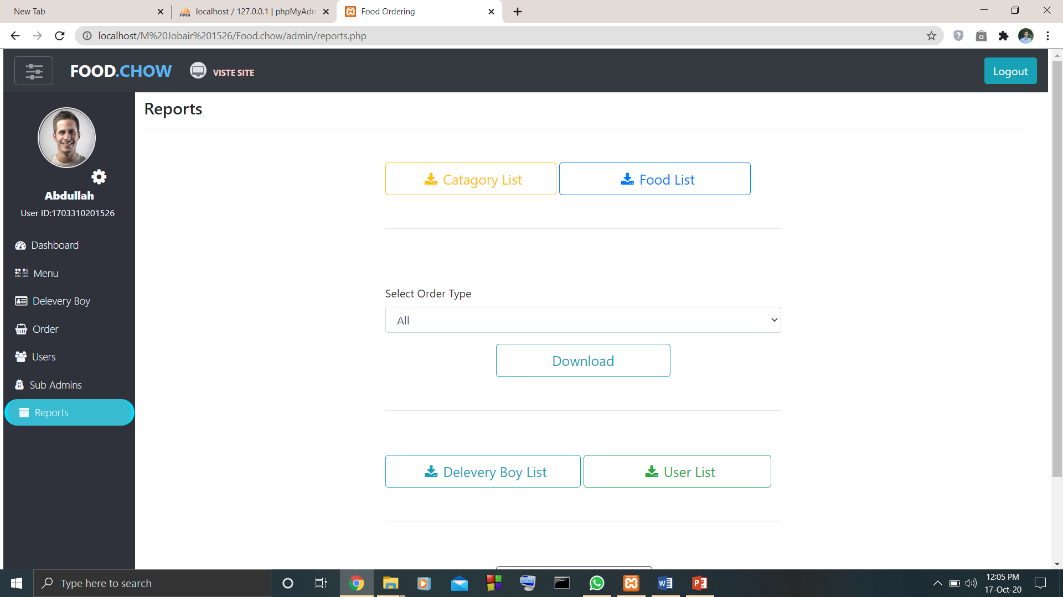
Screenshots of some important features

Slide 23
Limitations and Future Works
Though we have tried to make this project fully advance and complete but as a first web project and beginner level project it was very difficult. Future works which are given below can make this web application more advance and efficient. Those works are:
Verifying user registration by email or phone number.
Forget password and remember me option.
Payment Refund option.
Notifying user with email or SMS.
Profile and Managing new order delivery facilities for delivery boy.

Slide 24
Conclusion
In this project we have tried to develop a simple and effective web application to order food online with payment with card and for managing food order, food menu, sales online. We hope our project will contribute in modernizing food ordering system. While developing this web application we have faced syntax error and connection error because of not witting syntax and database name properly. we have also faced difficulties in designing the frontend of this project because of little knowledge in Bootstrap. To overcome this problem we have took help from different online website. After implementing the future work properly this web application will be advanced, complete and perfect.

Slide 25
References
www.google.com
www.youtube.com
https://getbootstrap.com
https://lucid.app
https://app.diagrams.net
https://github.com

Slide 26
THANK YOU

